Slide 1
Club Instagram page: HERE
Club Facebook page: HERE
Open 10mile Time Trial - Wednesday 19th June 2024 Formal Event Start Time: 18.45. First Rider Off At 18:46. Final Rider Off At 20:17 Promoted for and on behalf of Cycling Time Trials under their Rules and Regulations.
CTT Official Time Keepers: Mrs Tracy Moore & Mr Andrew Sawyer.
Event Start Official: Mr Peter McClure. Event Secretary: Mr James Hodgson. montythecat98@gmail.com
Event Headquarters / proposed parking – see following diagrams (page 4).
No parking on the pub car park or on the frontage of the Strickland Arms.
HQ / sign on is open from 18.00 and will be located on Nannypie Lane, LA8 8DZ.
Under 18s must bring a signed parental consent form – HERE
Riders are reminded not to attempt to cross the dual carriageway at any point and must encircle A6 / A590 roundabout on way to start line.
Riders must not ride with their head down.
1. ALL riders must use working front and rear lights attached to their machine. [Regulation 14(j)]. 2. ALL riders now must wear a helmet. (Previously this requirement was only mandatory for under 18s). [Regulation 15].

Slide 2
Local Regulations – L1015
Cycling Time Trials – North D.C. 2023 – Local Regulations L1015, L2524, L308
The following Local Regulations have been approved by the National Committee in accordance with Regulation 38 Any breaches may lead to disciplinary action being taken.
CTT Regulation 14 Competitors Machine – FRONT WHITE LIGHT & REAR RED LIGHT.
NO COMPETITOR shall be permitted to start either a Type A or Type B event unless such competitor has affixed to the front of their machine A WORKING FRONT WHITE LIGHT, either flashing or constant, that is illuminated and in a position that is clearly visible to other road users. A WORKING REAR RED LIGHT must be affixed to the rear of the machine, that is illuminated and in a position that is clearly visible to other road users
Regulation 17: Signing-on Sheet and Signing-Out Sheet:
(a) The Competitors in all types of events must make themselves aware of any special safety instructions for the event and sign the official Signing-on Sheet when collecting their number.
(b) In Type A events a competitor must return to the events HQ either during the event or within a reasonable time after the last rider has finished the event and must (i) return their number and (ii) sign the official Signing–Out Sheet
Local Reg No 5
For the duration of the event, competitors must not ride past the timekeepers, except when actually competing.
Local Reg No 6
Any competitor making a ‘U’ turn in the vicinity of the start or finish will be disqualified from the event
Local Reg No 10
Course L1015, L2524 & L308 – warming up on the course is not permitted during the duration of the event.
Local Reg No 12
No parking on the car park or on the frontage of the Strickland Arms.
Local Reg No 15
Riders must keep to the left-hand side of the road except when overtaking. Failure to comply with the above may lead to disqualification.
Riders must give their number at the finish and elsewhere on the course if requested.
Riders must NOT STAND in the road at the start or finish. (This constitutes obstruction and is a breach of Regulations).
Riders must NOT ride with their heads down.
Helmets:
All competitors MUST wear a HELMET of HARD/SOFT SHELL construction that conforms to a recognised Standard (See Regulation 15).

Slide 3
Risk Assessment, Rider Awareness Notes – L1015
Slip road on left where A6 joins onto A590, circa 500 yards after start line: WARNING, fast traffic joining A590 from slip road to left of riders. Riders to take particular care at this junction during the event times of 18:45 until the event is completed and all riders have signed out. Event marshals will be present.
Meathop roundabout - Lindale bypass. Riders encircle roundabout. WARNING, fast traffic joining. Riders need to enter centre of roundabout in front of passing traffic. Riders to take particular care at this junction during the event times of 18:45 until the event is completed and all riders have signed out. Event marshals will be present.
Note that there are numerous other minor exit / entry roads onto the A590 where cars could be present, including the active petrol station on the return leg of the course. Please remain vigilant during the event.
Riders partaking in the event are reminded to please be vigilant for vehicles by riding with your head up at all times.
No times will be given to competitors or supporters at the finish line. Riders must not stop after passing finish timekeeper.
During the event times will be uploaded to the ResultsSheet app (QR code will be present at HQ sign out) but will remain at the discretion of the event organiser to amend any and all times recorded, until the official publication of results is made to the CTT, once the event has finished.
A copy of the full Cycling Time Trials Risk Assessment for course identification L1015 - 10 miles Levens, Lindale, Levens, will be available at the event HQ via James Hodgson, from 1800 on the day of the event, during the event and until the event is completed and all riders have signed out.

Slide 4
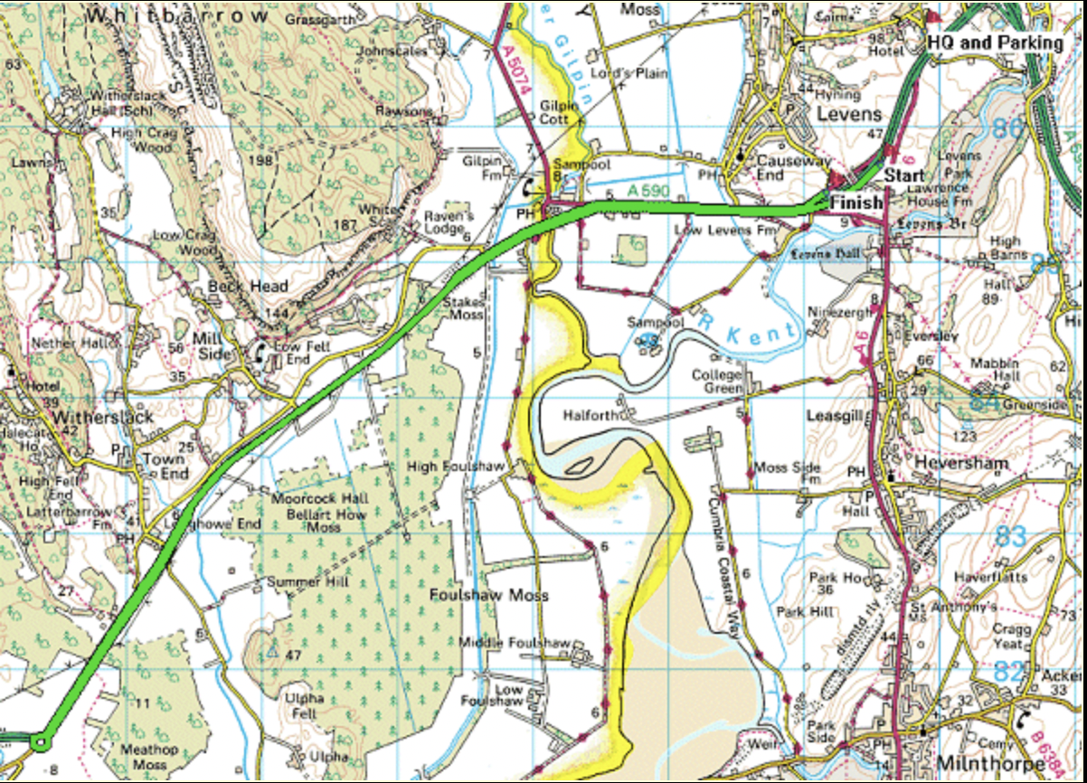
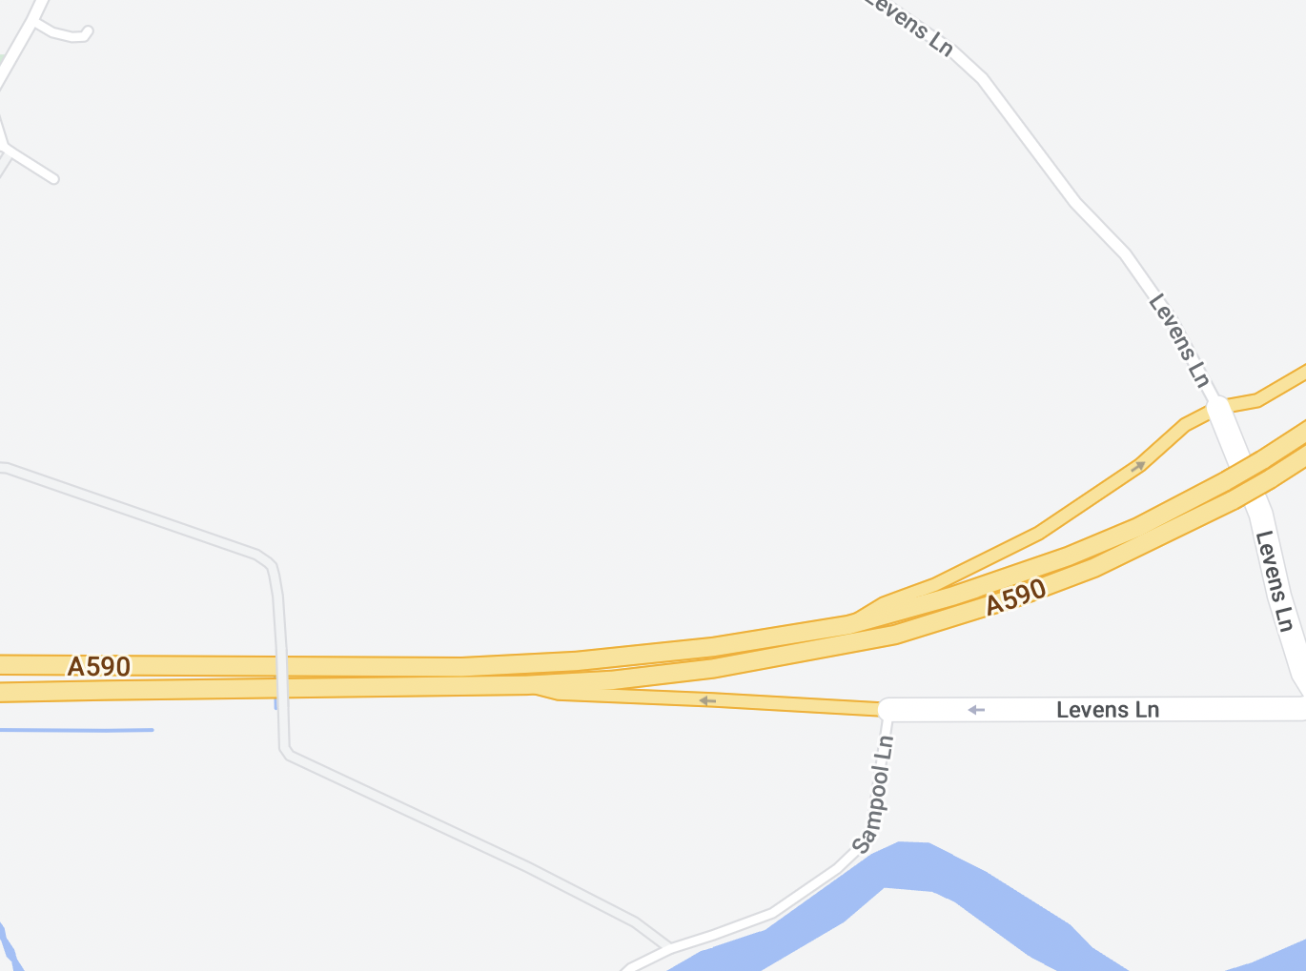
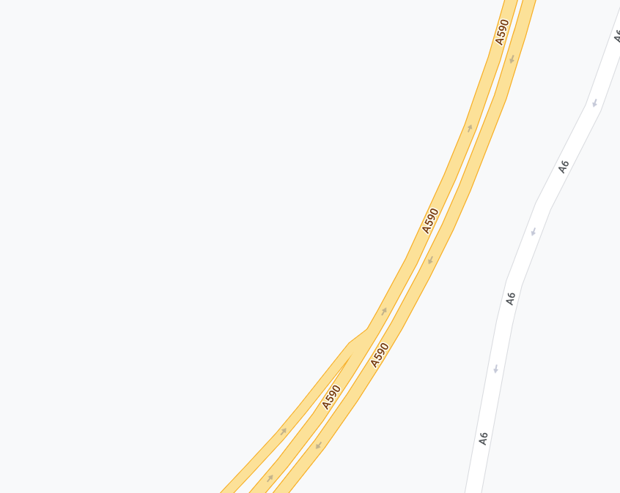
L1015 Levens Course Description
Start in lay-by on A590 approximately 500 yards south-west of junction with southbound A6 at the white mark on kerb edge which is 22 yards from the eastern end of the tarmac footpath and 33 yards east of an AA telephone point. This mark is directly in line with a wooden fence post with two angled supports in the hedge and almost in line with the most easterly of two "Please take your litter home" signs.
Proceed along the A590 in a south-westerly direction to encircle roundabout on Lindale by-pass (5.243 miles).
Re-trace along the A590 to FINISH in line with the metal cover in the northern grass verge embossed "Charlton Ironworks Sheffield" which is approximately 12 yards east of the large road sign on the slip road to the A6 approximately 90 yards short of the junction of Levens bridge / Levens village road (10 miles).
Club Instagram page: HERE
Club Facebook page: HERE
HQ/Parking 1 & 2
HQ/Parking 1
(Nannypie Lane).
LA8 8DZ
https://goo.gl/maps/65QEgamzE2VqMRCa6
Parking 2
(Nannypie Lane).
LA8 8DZ
https://goo.gl/maps/kkzbxuqh3UECcjNeA
Start/Finish
Finish
https://goo.gl/maps/u2DaMmssLkVHfLzo9
Start
https://goo.gl/maps/jaunY6FqV1kxwvhTA
Course: L1015 - Levens Length: 10 miles Ascent: 41m

Slide 5
Prizes:
Please contact James Hodgson, Barrow Central Wheelers Chairman at: montythecat98@gmail.com to your claim winnings once the official results are published by the CTT.
Category | No of Riders | 1st Place | 2nd Place | 3rd Place
C5 Female | 1 | £15 | £N/A | £N/A
Junior Female | 2 | £15 | £10 | £N/A
Senior Female | 3 | £15 | £10 | £10
Veteran Female | 4 | £15 | £10 | £10
Category | No of Riders | 1st Place | 2nd Place | 3rd Place
Youth Male | 2 | £15 | £10 | £N/A
Junior Male | 3 | £15 | £10 | £10
Espoir Male | 1 | £15 | £N/A | £N/A
Senior Male | 14 | £15 | £10 | £10
Veteran Male | 62 | £15 | £10 | £10
Category | No of Riders | 1st Place | 2nd Place | 3rd Place
Trike Male | 2 | £15 | £10 | £N/A
Category | No of Riders | 1st Place | 2nd Place | 3rd Place
Road Bike Male Senior | 3 | £15 | £10 | £10
Road Bike Make Veteran | 3 | £15 | £10 | £10

